Slide 1
Optimizing Merage’s Online Advertising - SMP Data
Group 9
Sujaya, Sammi, Isha, Song, Poonam

Slide 2
AGENDA
1
2
3
4
PROJECT SCOPE
PROJECT SCOPE
DATA, EXPLORATION, RECOMMENDATION
OVERALL CONCLUSIONS
Q&A

Slide 3
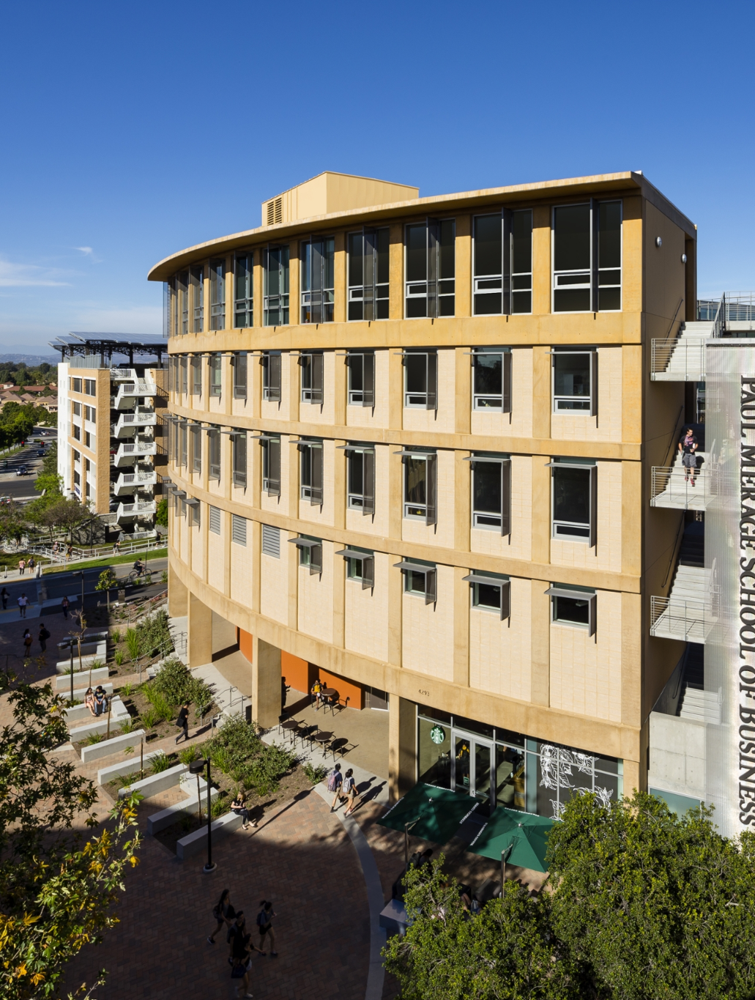
PROJECT OVERVIEW

Slide 4
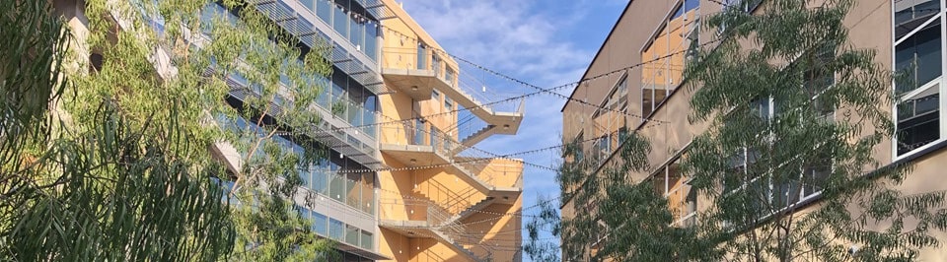
PROJECT SCOPE
PROJECT SCOPE
Help Merage improve online advertising strategy for SMP
Improve Merage campaigns on search engines and social media platforms
Maximize number of submitted applications and overall clicks on their digital advertising campaigns

Slide 5
KEY QUESTIONS
What platforms are optimal to advertise on?
Can we maximize the number of application submissions?
What types of applicants are more likely to apply?
Which leads increase chances of applying?
How can we improve click and conversion rates?
Do application submission dates tell us anything about applicant behavior?

Slide 6
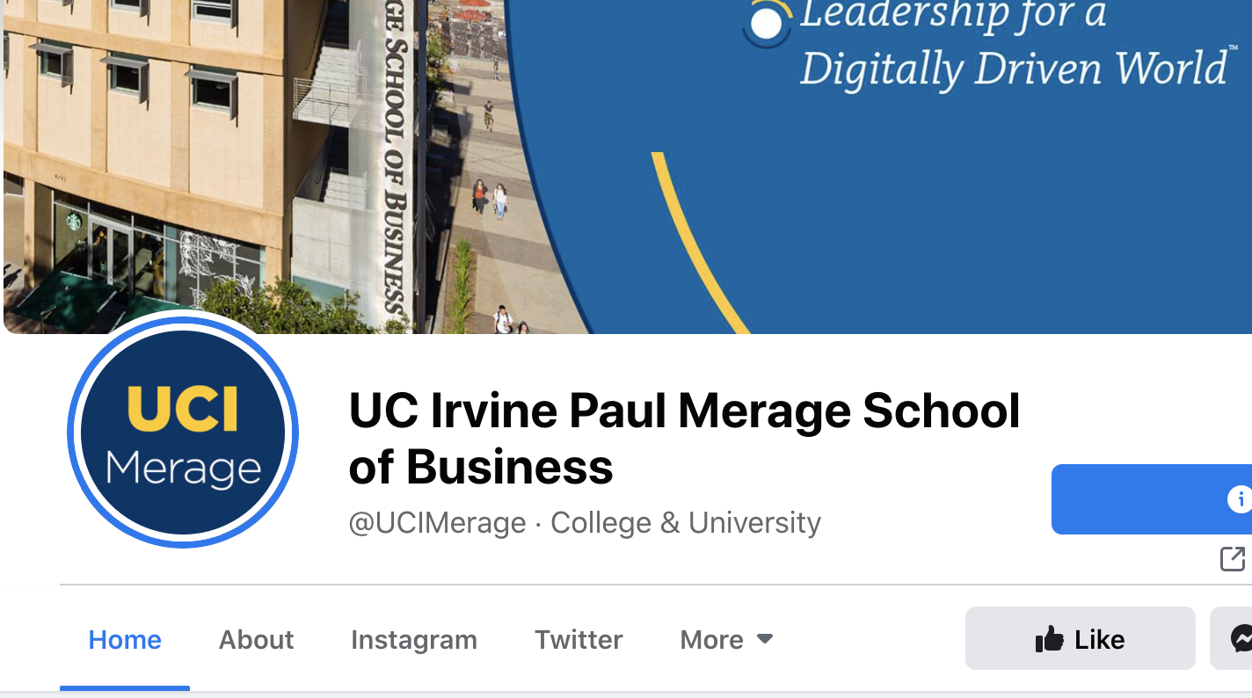
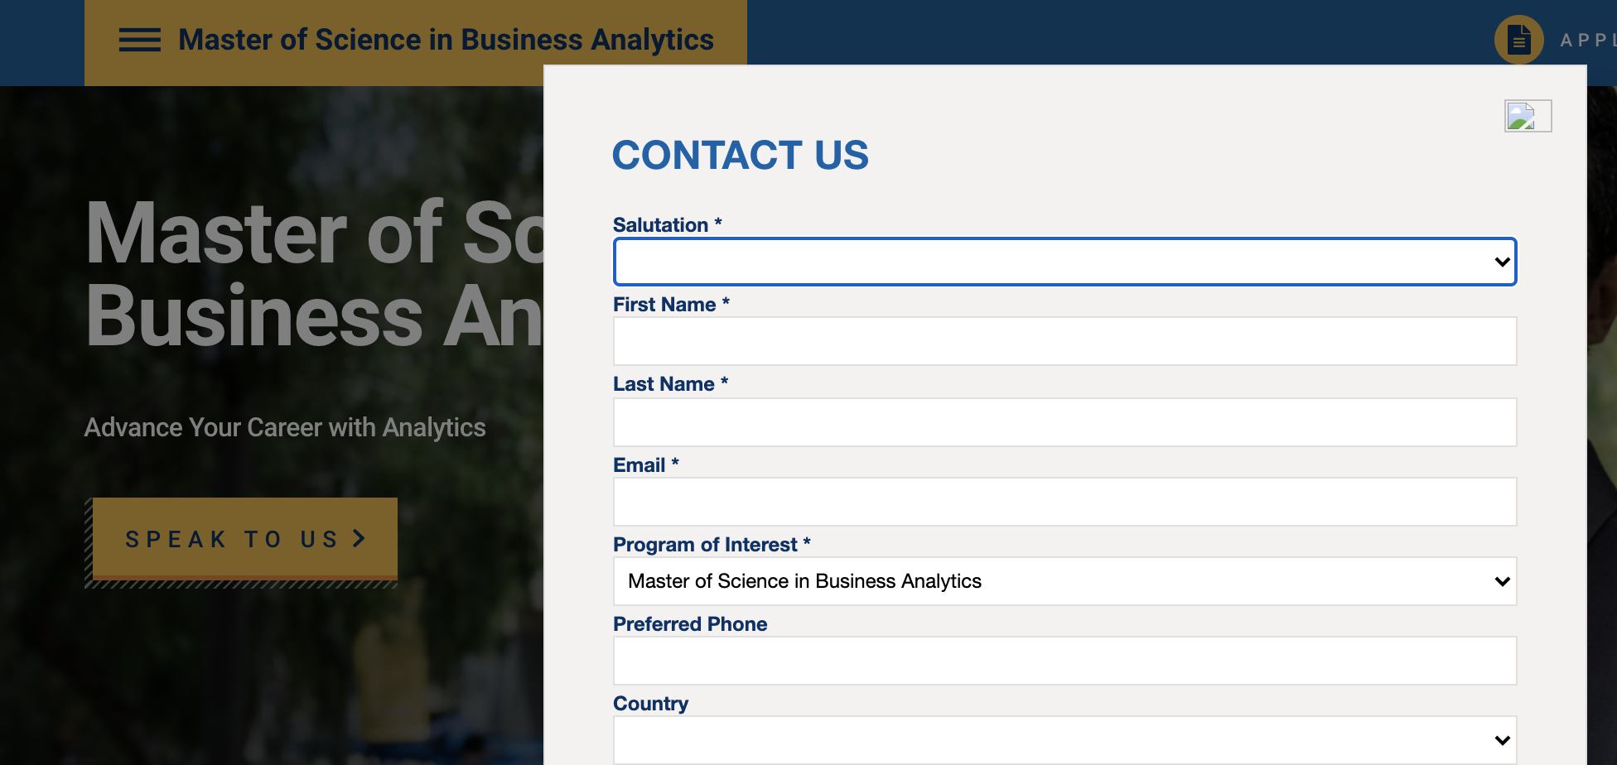
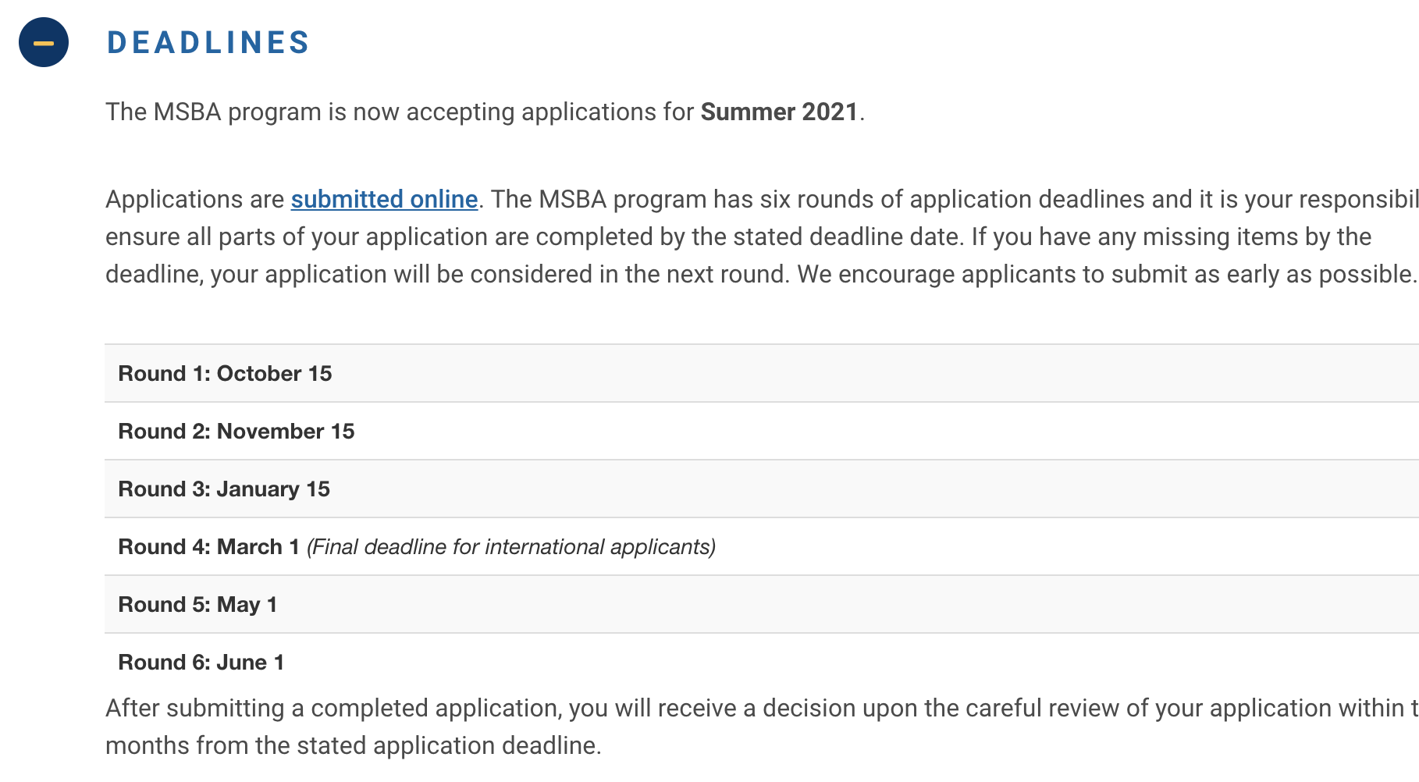
DATASETS
Applicants
Engagement and performance data
Variables of interest:
Unique clicks
CTR
Campaign
Leads
Lead source data
Date of first visit and application submit date
Residency data
Program data
Variables of interest:
Time elapsed
Lead source data (web inquiry forms, events)
Date of first visit
Gender
Variables of interest:
Stage: Archive, Applicant, Inquiry

Slide 7
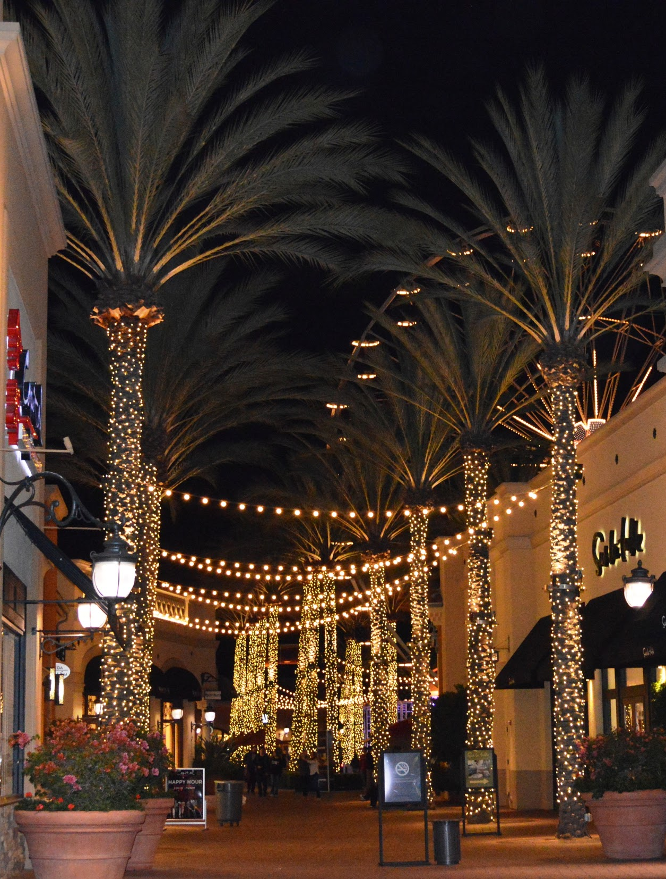
CAMPAIGN DATA

Slide 8
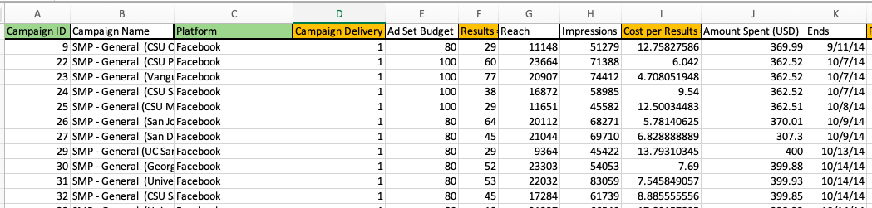
Data Prep and Cleaning
Add Compaign_ID column
Delete columns with too few values/input
Filter SMP and add column "Platform' with text mining function (grep)
Change columns 'End' and 'Starts' to date format
Dummy Variables to indicate the delivery of campaigns

Slide 9
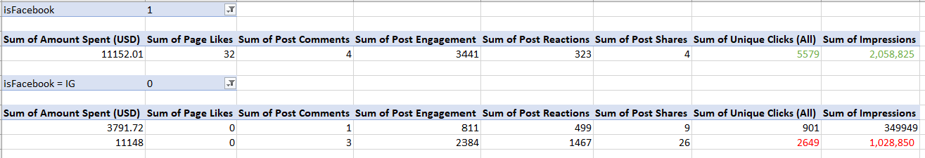
Exploratory Data Analysis
Instagram advertising is more expensive than FB. If we try to replicate the spend,
we can see that for the same spend, we get only half the clicks and impressions.

Slide 10
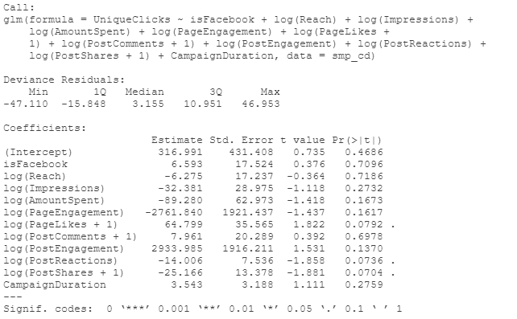
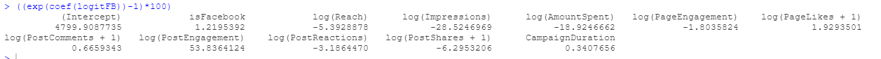
Modeling
At a 0.1 alpha level, page likes, reactions, and shares are significant.
Page likes have a positive effect on unique clicks.
A 1% increase in page likes results in a 1.93% increase in odds of gaining unique clicks.
A 1% increase in post reactions results in a 3.18% decrease in odds of gaining unique clicks.
A 1% increase in post shares results in a 6.3% decrease in odds of gaining unique clicks.

Slide 11
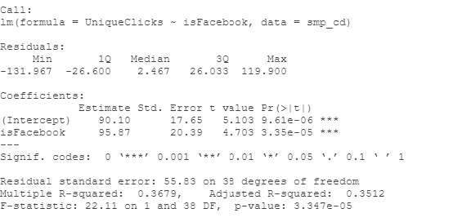
Modeling
If a campaign runs on Facebook, it is likely to get about 95 more clicks than if it were to run on Instagram.
IG base clicks: 90 clicks
FB clicks: 185 clicks
Facebook is better for advertising because we get a higher amount of clicks per campaign as compared to Instagram

Slide 12
Recommendations
Merage should focus on people who like the post rather than engage with the post (share/react)
Page likes have a positive effect on unique clicks.
Continue to advertise in a higher proportion on Facebook than on Instagram for SMP
Facebook gets higher clicks per campaign than Instagram

Slide 13
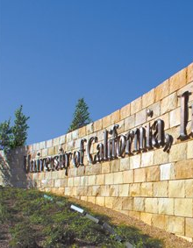
LEADS DATA

Slide 14
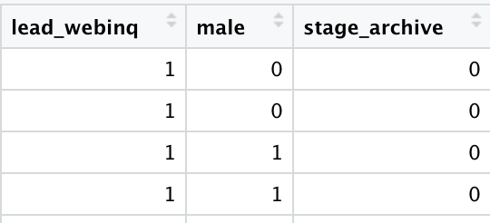
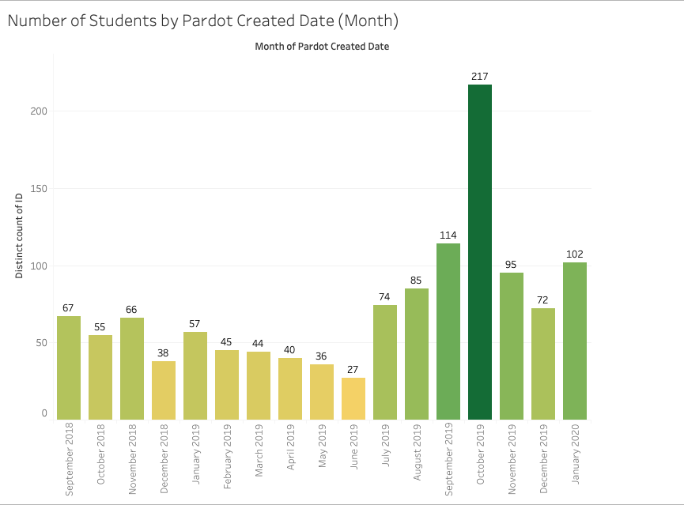
Data Prep and Cleaning
Dummy Variables Transformation: gender, student stage, lead source data
Mapping the date first visited as variable time_til_oct: absolute value difference
Visits to the website spike during October; application window opens in September

Slide 15
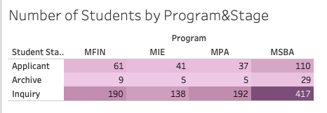
Exploratory Data Analysis: Programs
MSBA program has more inquiries than other programs, which leads to higher applicant and archive numbers.
Notes:
“Inquiry” is anyone that registers for more information from a campaign but does not start an application.
“Applicant” refers to anyone that has started an application but may not have completed it.
“Archive” means that the student completed their application and an admissions decision has been made (accept, deny, or decline.) “Archive” applicants are the most valuable kinds of conversions for us.

Slide 16
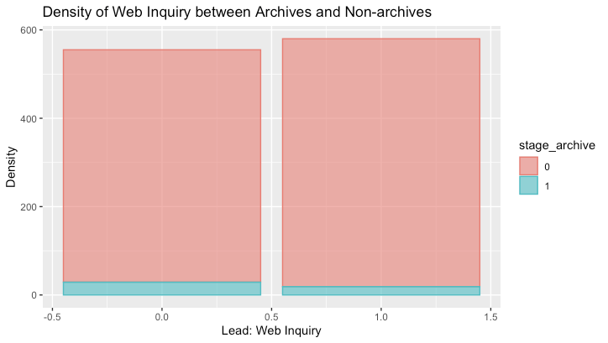
Exploratory Data Analysis: Archives
Non-archives are more likely to file a web inquiry (red), and Archives are more likely to not file a web inquiry (blue).

Slide 17
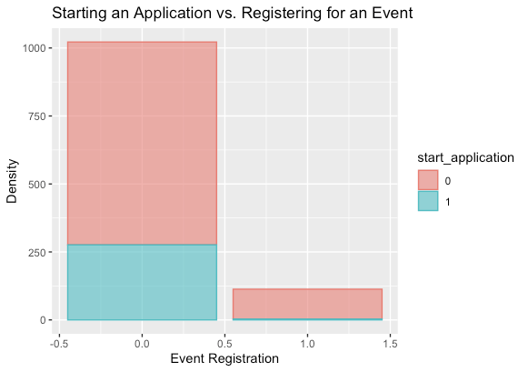
Exploratory Data Analysis: Events
Many people who start an application do not come from an event registration lead.

Slide 18
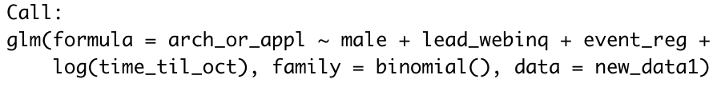
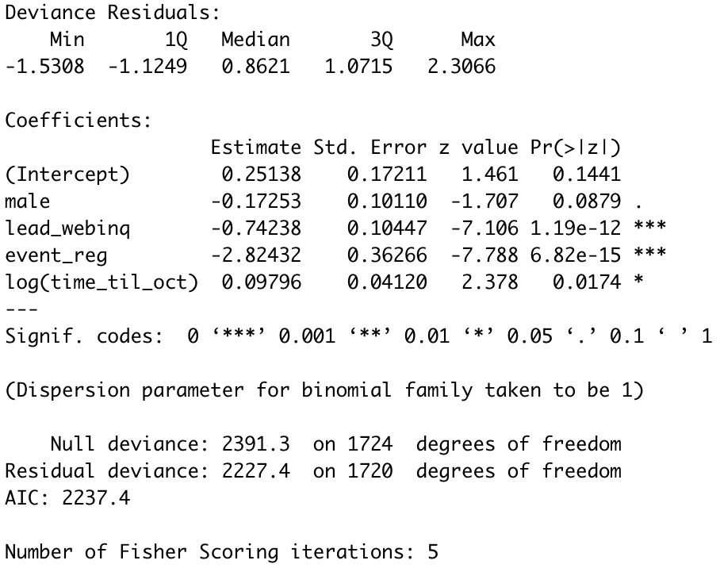
Modeling
Logistic Regression:
Predicting if they will start an Application
If an applicant fills out a web inquiry form or registers for an event, then they are less likely to start an application than those who don’t.
Notes:
1 start application
0 stuck in inquiry stage
a lot of people apply without submitting web inquiry form or event registration
most applicants submit close to october

Slide 19
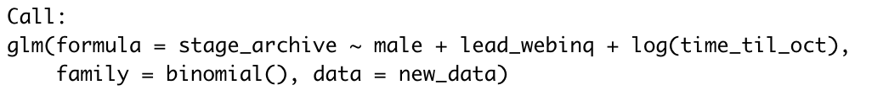
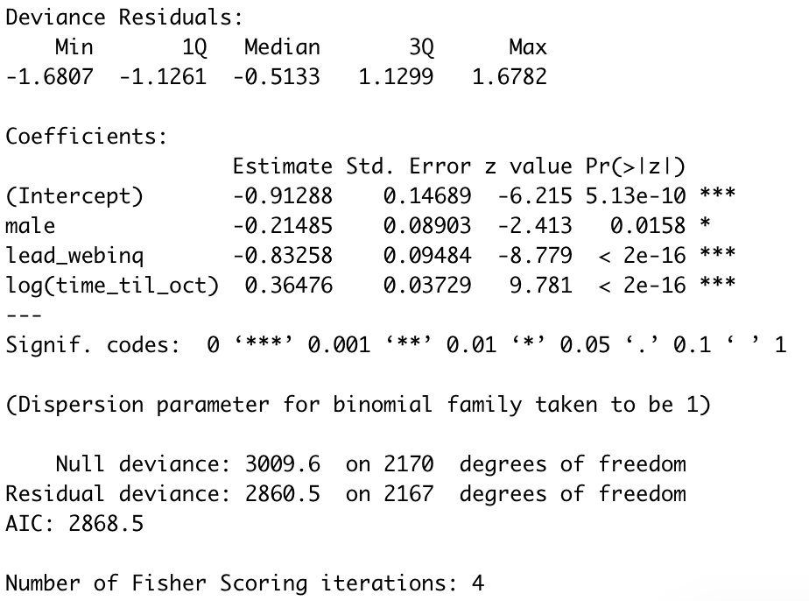

Modeling
Logistic Regression:
Predicting if they will submit application or not
When a student fills out a web inquiry form, their odds of applying decreases by 6%
May be because these students are unsure of applying and therefore submit a web inquiry form.

Slide 20
Recommendations
We recommend Merage to take a closer look at calls to action & reactions of those who fill out forms and attend the event
Inquiry Form & Event Registration doesn’t have positive impact on submitting application
Conduct in depth analysis on why males drop off in the conversion funnel as opposed to females
Females are more likely to apply even though more males express more overall interest in programs

Slide 21
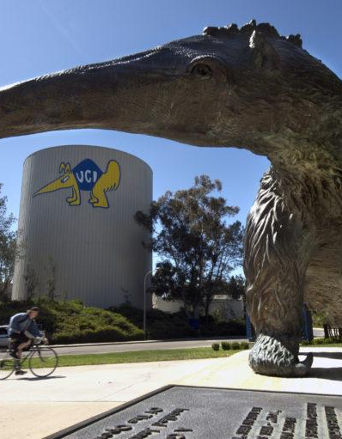
APPLICANTS DATA

Slide 22
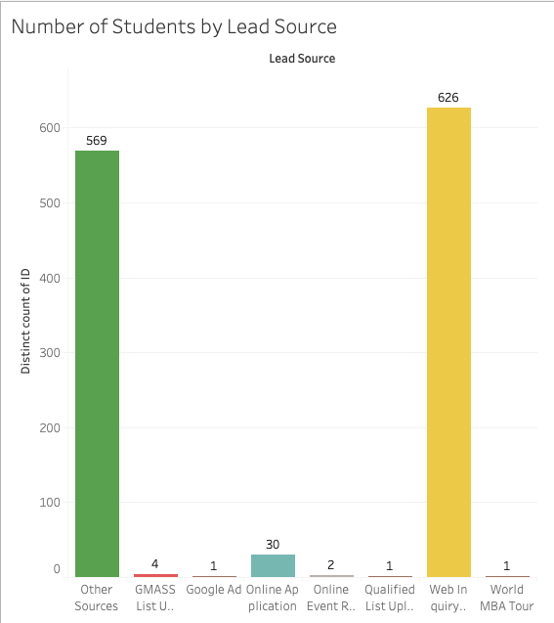
Exploratory Data Analysis
Other sources indicates leads from other sources such as grescoresender, hobsons, gradfair, and gmat.
Merage School Web Inquiry form supplies the most leads
Traffic most likely being driven from other sources
Notes:
“Lead Source” is a field from Salesforce and is a general category for how the inquiry originally entered our system (e.g. web form, application, list upload, etc.)

Slide 23
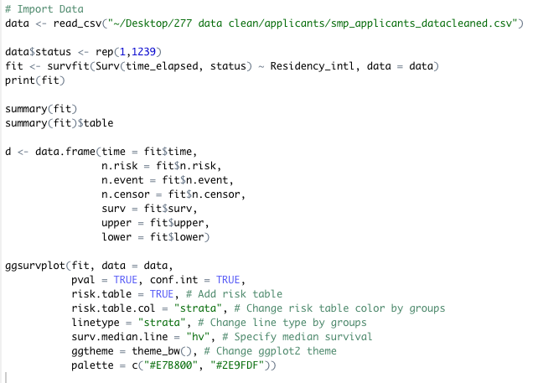
SURVIVAL ANALYSIS
time elapsed calculated field
lead source information
residency status
program data

Slide 24
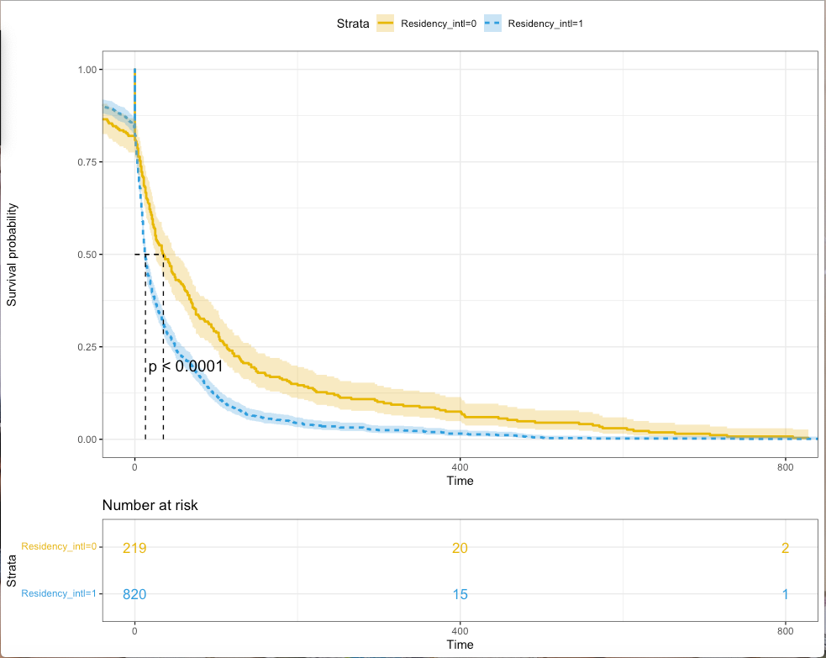
Survival Analysis: Citizenship
Compared to citizens, international students are more likely to submit applications earlier.
Notes:
Survivor probability: The probability that a student will “survive” past time period j (will not have submitted the application up to the end of time j)

Slide 25
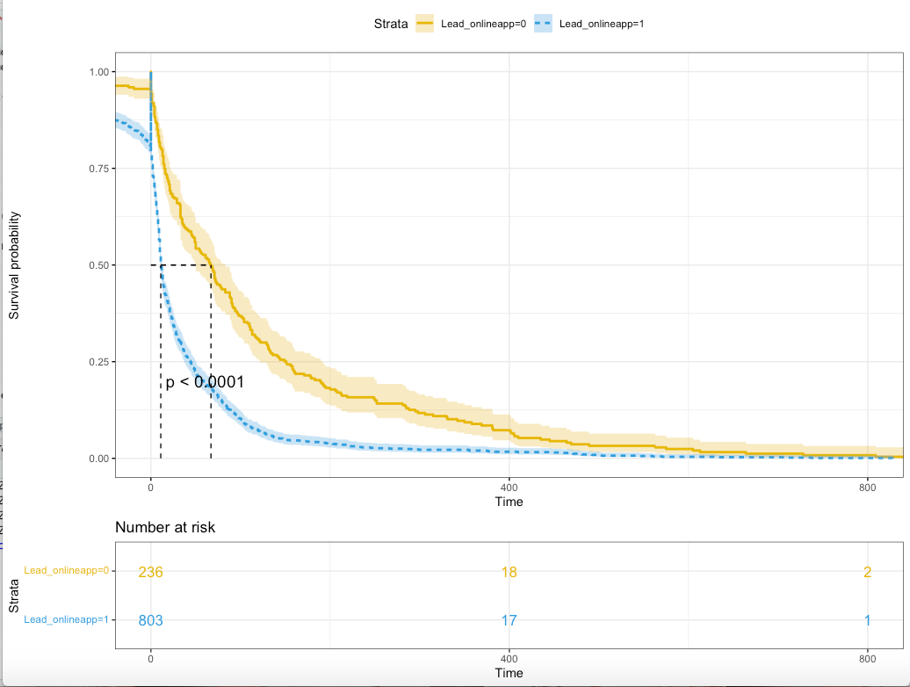
Survival Analysis: Online Application
Compared to applicants from other sources (like gmat, grescoresender,gradfair, etc), Lead_online_applicants (direct applicants) are more likely to submit applications early.
Notes:
Survivor probability: The probability that a student will “survive” past time period j (will not have submitted the application up to the end of time j)

Slide 26
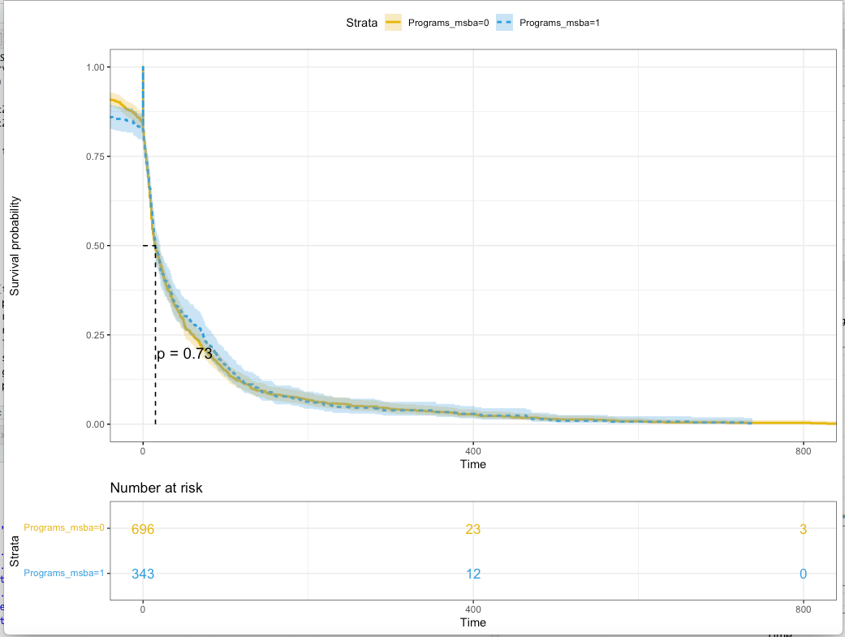
Survival Analysis: Programs
There is no significant difference in submission date between MSBA and non_MSBA.
Notes:
Survivor probability: The probability that a student will “survive” past time period j (will not have submitted the application up to the end of time j)

Slide 27
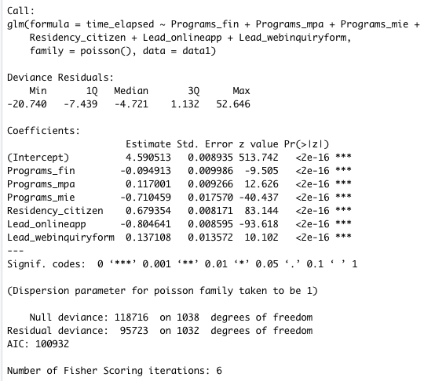
Modeling
Poisson Regression
At .001 alpha level: Almost all variables are significant.
Lead online applicants have a smaller elapsed time
Very small difference between elapsed time in the programs
Notes:
time_elapsed = submission date - first activate date
poisson because number of days is a count

Slide 28
Recommendations
Focus campaign efforts on international students in the beginning rounds and use targeted marketing for residents in later rounds
International Students apply earlier than Citizens
Direct online applicants have faster rates of submission
Prompt those who have expressed interests from other forms with reminders of submission deadlines
Elapsed time doesn’t vary much between programs
No need for Merage to focus campaign efforts based on deadlines

Slide 29
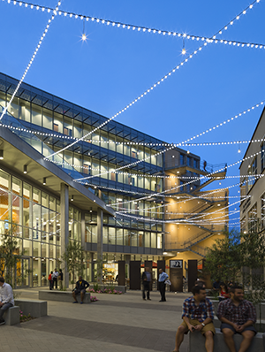
CONCLUSIONS

Slide 30
BUSINESS SOLUTIONS
Focused marketing efforts for Facebook and users who like the Merage FB page
Automate drip mailer communication planner for various lead stages from the conversion funnel
Take a customized effort to improve male conversion rate and to increase applicant numbers for female while retaining conversion rate
Target marketing toward international students for first few submission deadlines and residents for later deadlines
Minimize drop off from lead sources other than “online form” by improving engagement efforts

Slide 31

THANK YOU
Q&A

